Slide 1
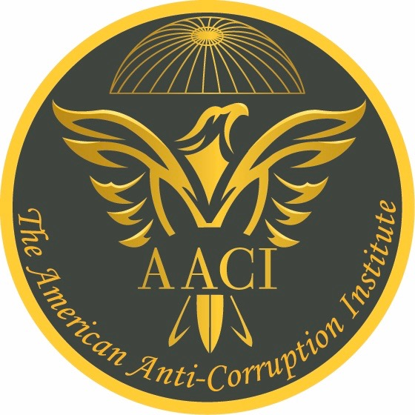
Principles of Anti-Corruption © ®
In Cooperation with
Tomorrow's Advice and Lebanon CACMs
Prepared and Presented By
Mike J. Masoud, CPA, CACM, CFE, MBA
Sr. Director of The AACI in the Middle East and Africa
Beirut - Lebanon
December 11, 2019

Slide 2
Copyright © 2019, The American Anti-Corruption Institute llc.
All Rights Reserved. No part of this publication may be reproduced, redistributed, transmitted or displayed in any form or by any means without written permission. For information regarding licensing and reprint permissions, please contact The American Anti-Corruption Institute (AACI), licensing and permissions for The AACI copyrighted materials. Direct all inquiries to copyright@THEAACI.com or to The American Anti-Corruption Institute (AACI), Attn: Manager, Rights and Permissions, 1204 East Baseline Road, Suite 106, Tempe, AZ 85283. Telephone inquiries may be directed to (603) 235-0956.

Slide 3
A bit About Us
The American Anti-Corruption Institute (AACI)
Tomorrow’s Advice s.a.r.l.
Lebanon CACM

Slide 4
Introduction
What is corruption?
Is there a corruption-free entity, community, or country? why?
Where does corruption flourish?
What are the ramifications of corruption?

Slide 5
Fighting Corruption
It is a process effected by those charged with governance, employees, citizens ,and other stakeholders to provide a reasonable assurance that those entrusted with power do not abuse it for a private gain(s). It is
Holistic,
Continuous,
Results-oriented,
Multidisciplinary, and
Encompasses all economic sectors

Slide 6
Principles of Anti-Corruption
The pervasiveness of the rule of law
Effective internal control
Effective and good governance
Independent and effective judiciary
Authority and associated accountability
Investment in corruption prevention
Quantification of corruption exposure

Slide 7
Principles of Anti-Corruption
Certainty of punishment
No statute of limitations
Rewarding corruption fighters

Slide 8
1. The Pervasiveness of the Rule of Law
ALL are equal before the law,
No nepotism,
What differentiates developed from developing countries, and
…….

Slide 9
2. Effective Internal Control
A process that aims to achieve reporting, operating and compliance objectives,
A pillar in corruption prevention, deterrence and detection,
Five components and seventeen principles, and
…….

Slide 10
3. Effective and Good Governance
Direct and control,
Separation between ownership and control,
Management is not governance,
Good Vs. corporate governance, and
…….

Slide 11
4. Independent and Effective Judiciary
Independence in appearance and in fact,
Effective and efficient,
Anti-corruption education for all the judiciary stakeholders, especially judges and
…….

Slide 12
5. Authority and Associated Accountability
Contractual relationship,
Authority and power,
A direct relationship between authority, accountability, and severity of punishment,
Business judgment rule, and
…….

Slide 13
6. Investment in Corruption Prevention
Anti-corruption learning (training),
Anti-corruption strategies and corruption prevention policies,
Whistleblowing policies,
Certified Anti-Corruption Manager (CACM),
Organizations Anti-Corruption Certification Program, and
…….

Slide 14
7. Quantification of Corruption Exposure
Management and measurement,
Effectiveness of the fight against corruption,
Quantitative and qualitative,
Results – based process and
…….

Slide 15
8. Certainty of Punishment
Deterrence and certainty of punishment,
The rule of law and independent of judiciary,
No exceptions, and
…….

Slide 16
9. No Statute of Limitations
Deterrence, Deterrence, Deterrence,
Prevention is better than cure,
Why?, and
…….

Slide 17
10. Rewarding Corruption Fighters
Protect and reward,
National recognition,
Encourage others to speak up, and
…….

Slide 18
So, What’s Next?
The National Anti-Corruption Strategy Vs. The Principles of Anti-Corruption,
Institutionalization of the fight against corruption,
Public engagement, citizenry, and patriotism,
Integrity and The Principles of Anti-Corruption
Corruption Amount
Dec. 9, 2019
Dec. 9, 2020

Slide 19
Q and A
Thank You

Slide 20
Worldwide Presence
The U.S.
The Middle East and Africa
Dubai
Saudi Arabia
State of Qatar
Lebanon
Jordan
Iraq
Palestine
Nigeria
Kenya
South Africa
European Union
United Kingdom
Ireland
Netherlands
Belgium
Malta
Strasburg
Canada

